Slide 1
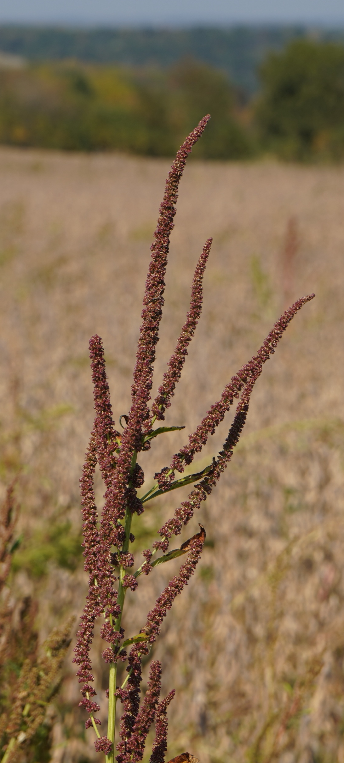
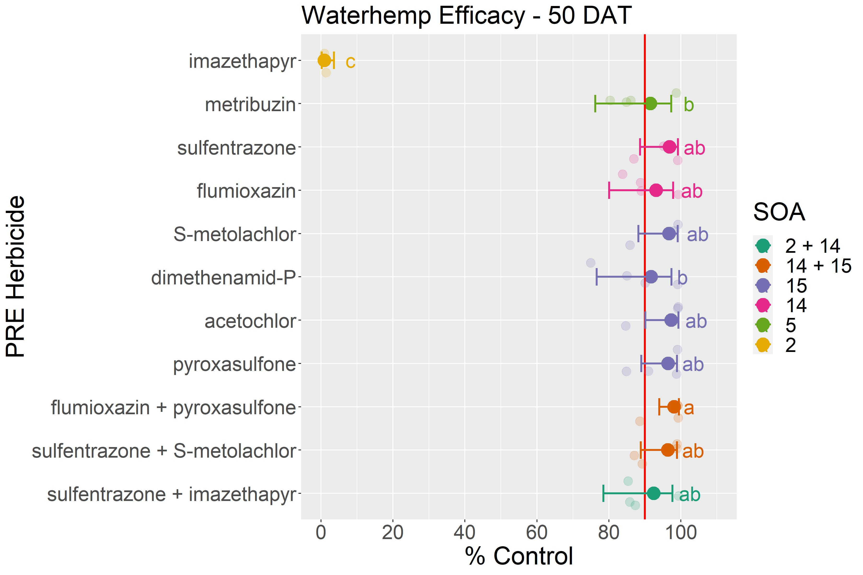
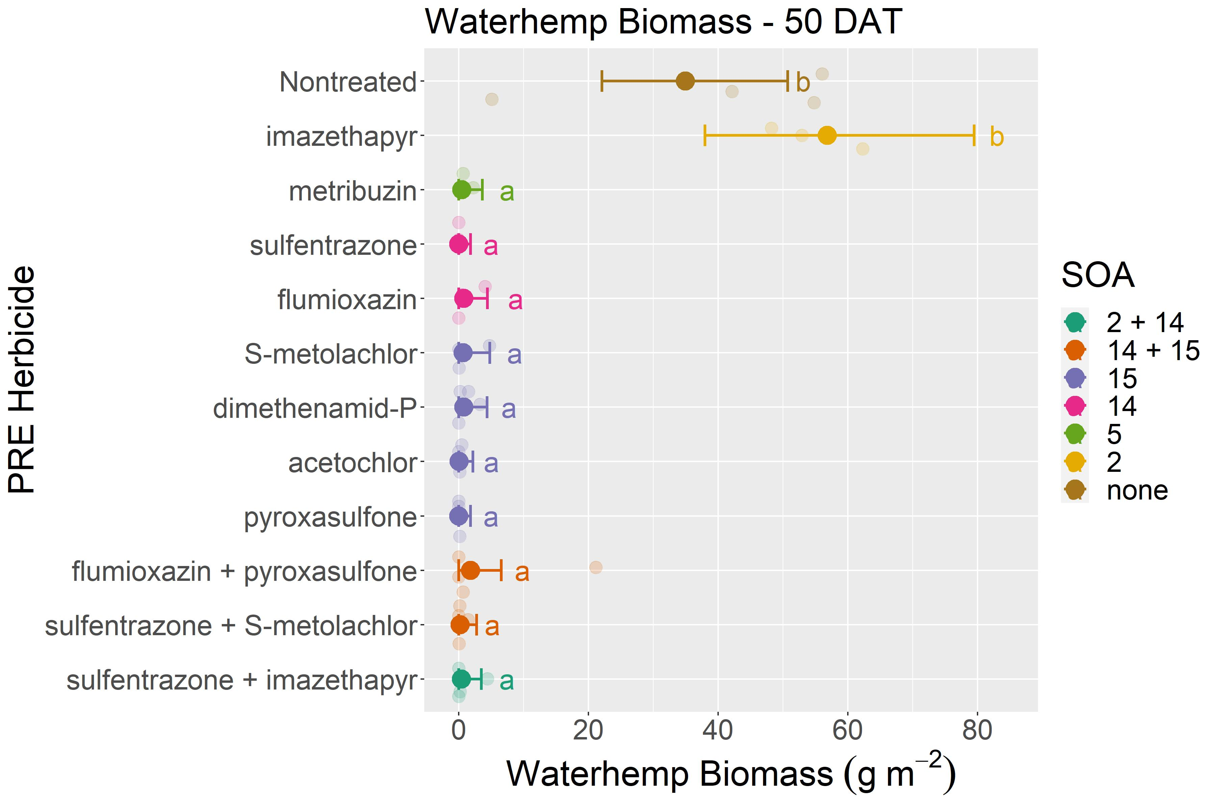

Managing Waterhemp in Soybean on Low Organic Matter and Elevated pH Soils with Residual Herbicides
Limited PRE herbicides are available to effectively control waterhemp in soybean on sandy soils with low organic matter and elevated soil pH.
Daniel H Smith*, Jamie Patton, Scott Reuss, Maxwel Coura Oliveira, Kolby Grint, Ryan P DeWerf, Nicholas J Arneson, and Rodrigo Werle. University of Wisconsin-Madison
INTRODUCTION
Waterhemp (Amaranthus tuberculatus (Moq.) J. D. Sauer) is a troublesome weed species in soybean production across the US North Central region.
An extended emergence window, rapid growth rate, multiple site-of-action (SOA) resistance, and limited postemergence (POST) control options have resulted in an increased reliance on preemergence (PRE) herbicides for waterhemp control in soybean.
Herbicide label restrictions for sand and loamy sand soils with low soil organic matter (SOM) and/or high pH challenge herbicide selection and application rates.
Objective
Evaluate the efficacy of PRE herbicides for waterhemp control in soybean grown in sandy soils with low soil organic matter and high pH.
Methods
Figure 1. 2021 waterhemp control ratings 50 days after treatment (DAT) at Navarino, WI. Error bars represent the 95% confidence intervals. Red line = 90% control.
A soybean study was established near Navarino, WI (loamy fine sand, pH=7.5 and 2.2% SOM) in the spring of 2021.
The trial followed corn and was chisel-plowed and spring cultivated prior to establishment.
Soybean were planted at 345,947 seeds ha⁻¹ (variety: Pioneer 22T18) on May 12, 2021.
Herbicide treatments consisted of single SOA and multiple SOA premix combination products.
Herbicide treatment and rate selection were based on SOM and pH characteristics, groundwater depth application restrictions, and additional label requirements.
Herbicides were applied within three days of planting with a CO₂ -pressurized backpack sprayer delivering 140 L ha⁻¹ of spray solution using TTI110015 flat-fan nozzles.
No POST herbicides were applied to the study.
Fifty (50) days after treatment (DAT), waterhemp control (%) was assessed, and weed biomass was sampled and forced air dried at 60° C until achieving a constant dry weight.
Figure 2. 2021 waterhemp biomass 50 days after treatment (DAT) at Navarino, WI. Error bars represent the 95% confidence intervals. Red line = 90% control.
Summary
At 50 DAT, the metribuzin, sulfentrazone, flumioxazin, acetochlor, dimethenamid-P, pyroxasulfone, S-metolachlor and all multiple SOA treatments provided >90% waterhemp control.
This trial demonstrates the effectiveness of limited PRE herbicide options available to control waterhemp in sand and loamy sands soils with low organic matter and elevated soil pH.
This information is crucial to help farmers improve waterhemp management under these challenging soil environments.
The trial will be repeated in 2022 in additional locations with similar challenging soil conditions.
Table 1. Herbicide treatment information
Herbicide | Rate | Site of Action (SOA) Group
imazethapyr | 0.3 L ha⁻¹ | 5
metribuzin | 560 g ha⁻¹ | 5
flumioxazin | 210 g ha⁻¹ | 14
sulfentrazone | 0.3 L ha⁻¹ | 14
acetochlor | 3.5 L ha⁻¹ | 15
S-metolachlor | 1.6 L ha⁻¹ | 15
dimethenamid-P | 1.0 L ha⁻¹ | 15
pyroxasulfone | 147 g ha⁻¹ | 15
sulfentrazone + imazethapyr | 0.4 L ha⁻¹ | 14 + 2
S-metolachlor + sulfentrazone | 1.8 L ha⁻¹ | 15 + 14
flumioxazin + pyroxasulfone | 210 g ha⁻¹ | 14 + 15
Acknowledgements: Special thanks to the host farm for this study, industry partners for providing chemical products, and members of the Cropping Systems Weed Science Program for their technical assistance.
*Author’s Email: dhsmith@wisc.edu

